Slide 1
Python Lecture 2

Slide 2
Python If-else statements
Decision making is the most important aspect of almost all the programming languages.
As the name implies, decision making allows us to run a particular block of code for a particular decision.
Here, the decisions are made on the validity of the particular conditions. Condition checking is the backbone of decision making.
In python, decision making is performed by the following statements.

Slide 3
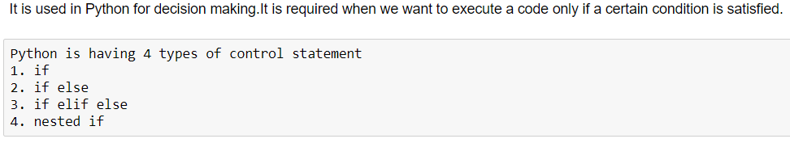
Python Control Statements

Slide 4
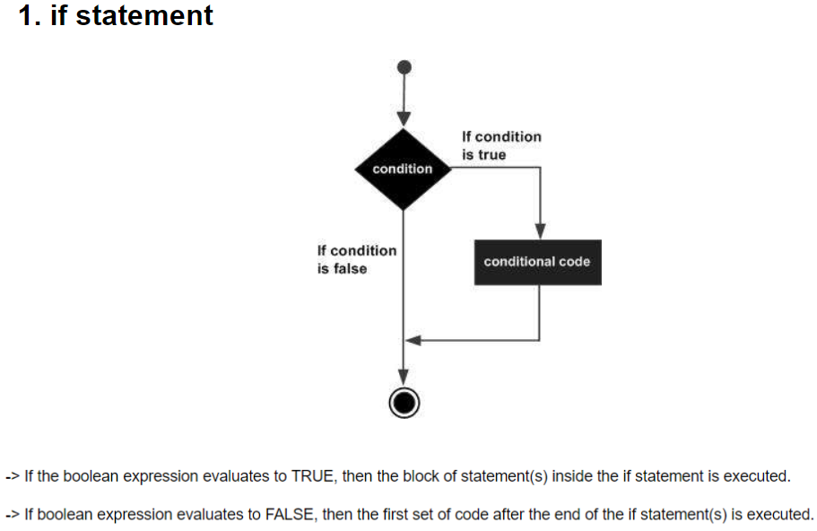

Slide 5
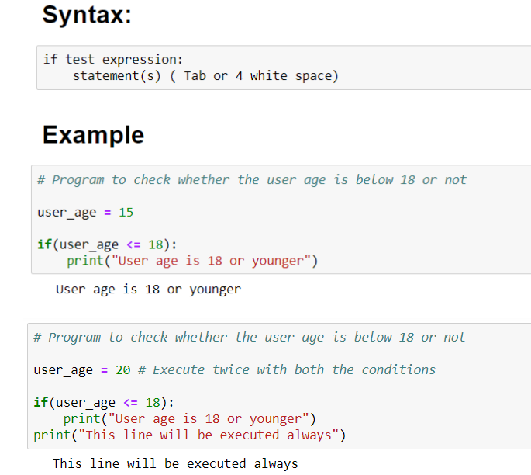

Slide 6
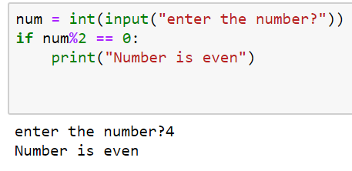
For the ease of programming and to achieve simplicity, python doesn't allow the use of parentheses for the block level code.
In Python, indentation is used to declare a block. If two statements are at the same indentation level, then they are the part of the same block.
Generally, four spaces are given to indent the statements which are a typical amount of indentation in python.
Indentation is the most used part of the python language since it declares the block of code. All the statements of one block are intended at the same level indentation.

Slide 7
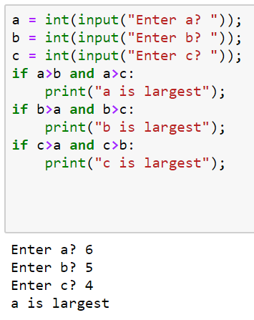

Slide 8
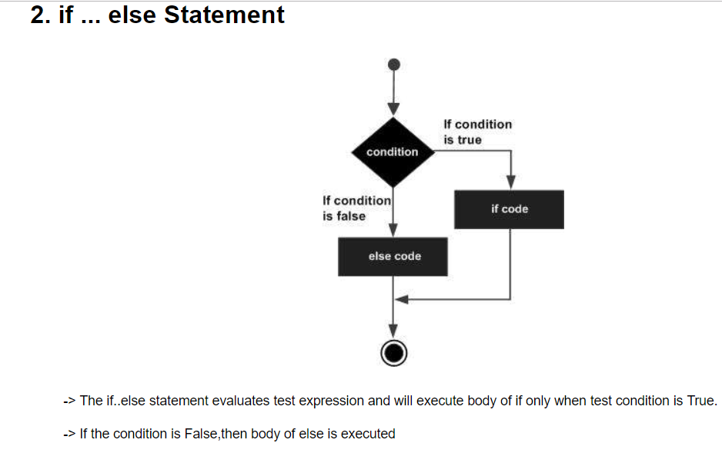
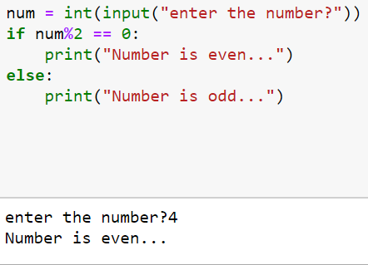

Slide 9
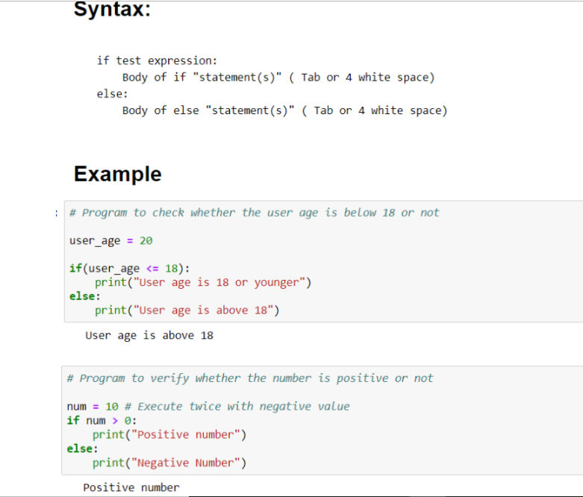

Slide 10
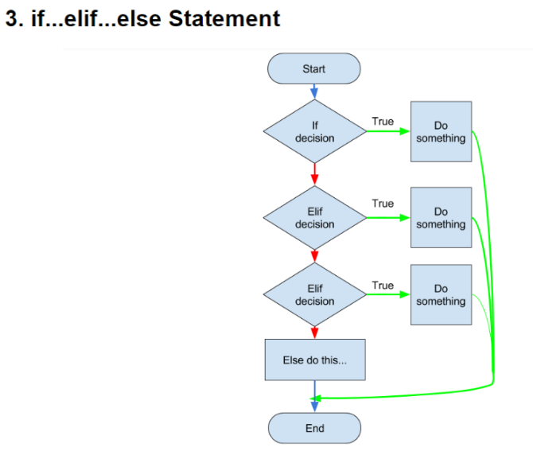
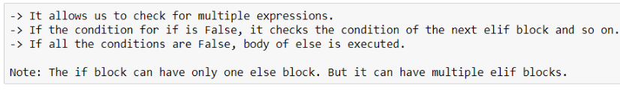
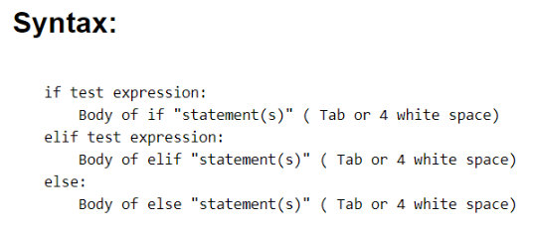
The elif statement works like an if-else-if ladder statement in C. It must be succeeded by an if statement.

Slide 11
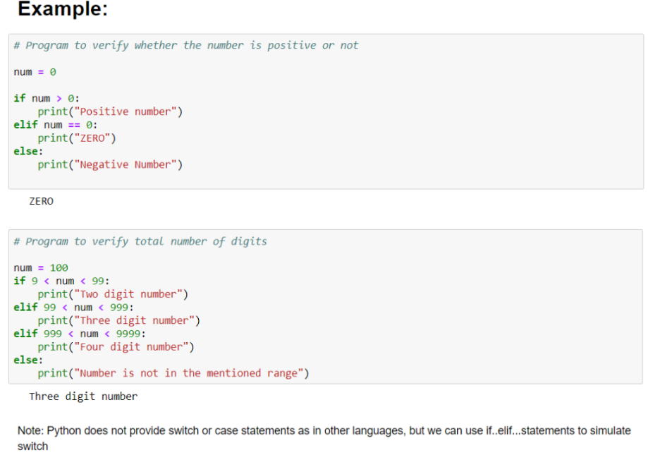
Test:
marks > 80 then A+
70>marks<+80 then A
60>marks<=70 then B
50>marks<=60 then C
Else fail
Mini Calculator
Enter operations: +,-,*,/,%,**
Enter two numbers:

Slide 12
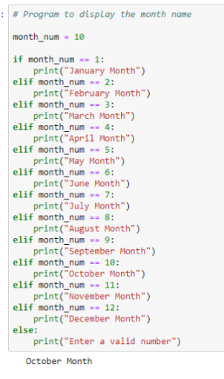

Slide 13
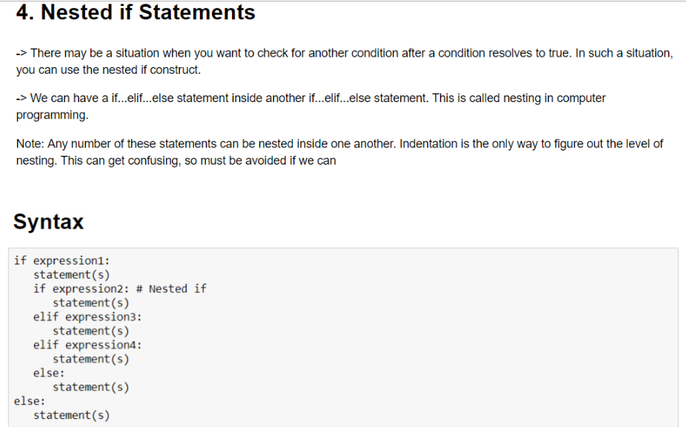

Slide 14
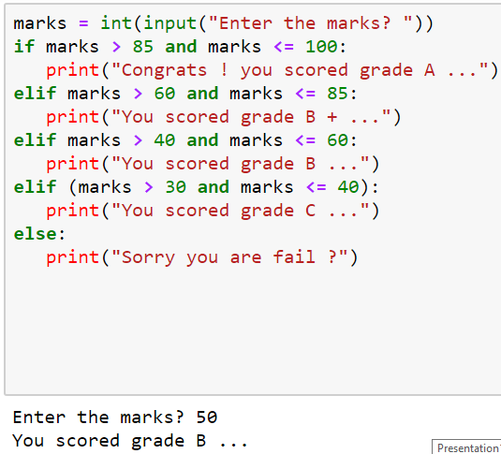

Slide 15
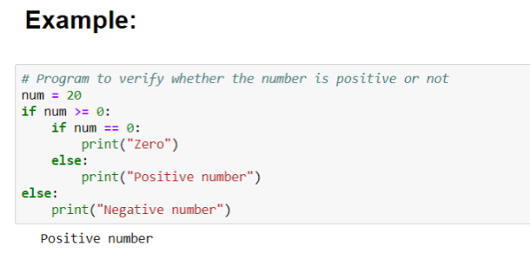

Slide 16
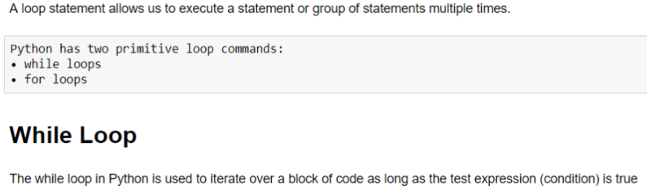
Python Loops
Advantages of loops
There are the following advantages of loops in Python.
It provides code re-usability.
Using loops, we do not need to write the same code again and again.
Using loops, we can traverse over the elements of data structures ( lists, tuples, dictionaries).
The print() function inserts a new line at the end, by default In Python 3, "end =' '" appends space instead of newline.

Slide 17
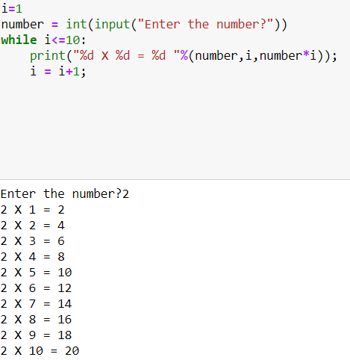
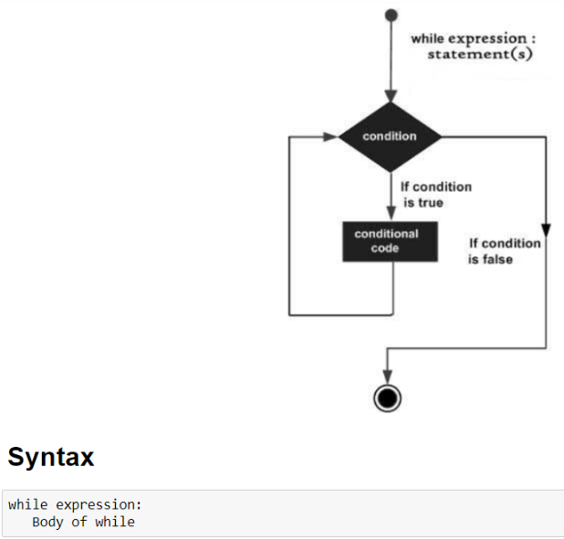

Slide 18
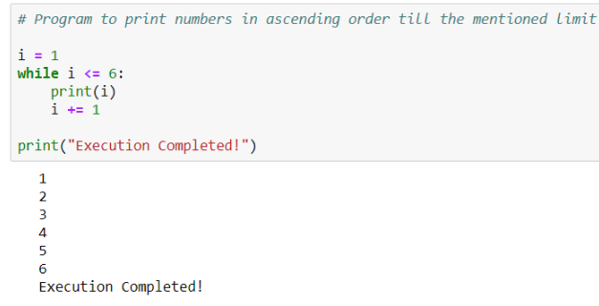
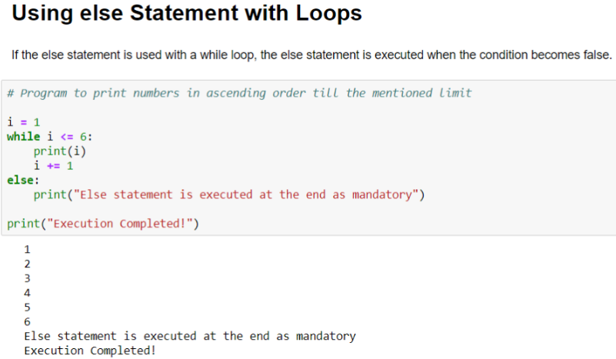

Slide 19
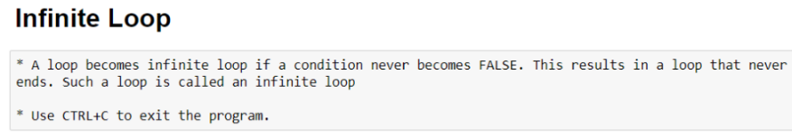
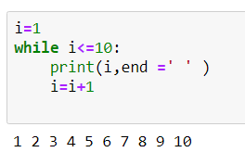
i>0

Slide 20
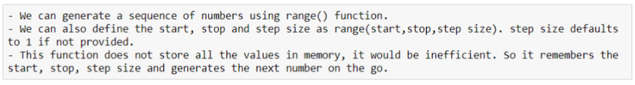
The range() Function
If you do need to iterate over a sequence of numbers, the built-in function range() comes in handy.
It generates arithmetic progressions:
for i in range(5)
print(i) //0 1 2 3 4
The given end point is never part of the generated sequence;
range(10) generates 10 values(0 to 9), the legal indices for items of a sequence of length 10.
It is possible to let the range start at another number, or to specify a different increment (even negative; sometimes this is called the ‘step’):

Slide 21
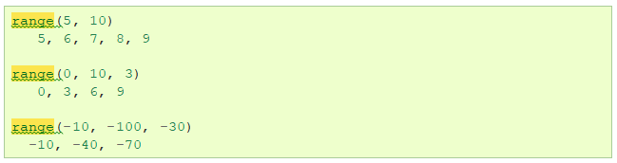
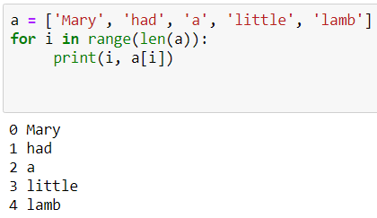
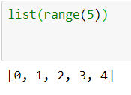


Slide 22
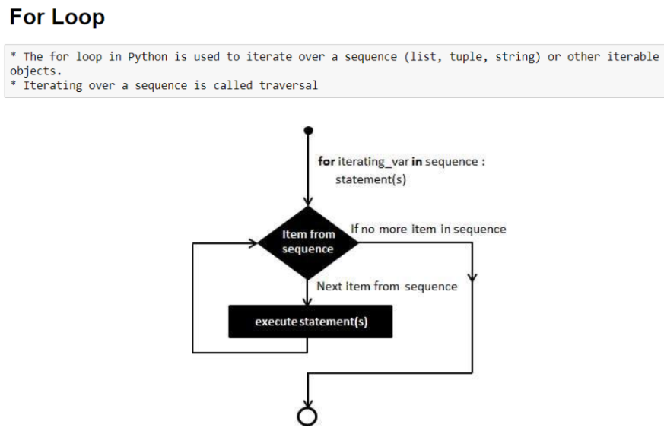

Slide 23
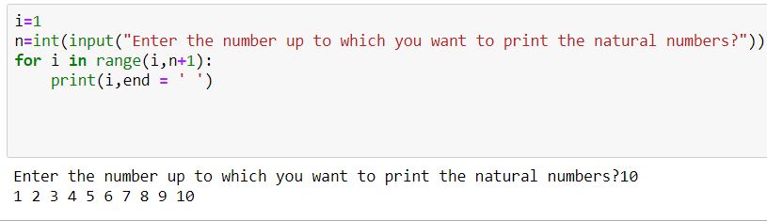
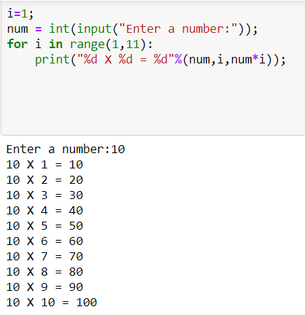
For loop

Slide 24
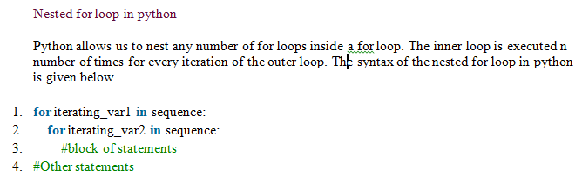
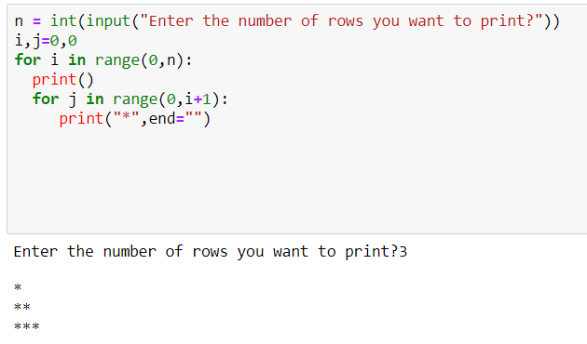

Slide 25
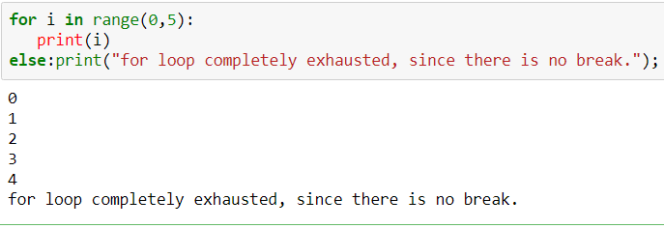
python allows us to use the else statement with the for loop which can be executed only when all the iterations are exhausted. Here, we must notice that if the loop contains any of the break statement then the else statement will not be executed

Slide 26
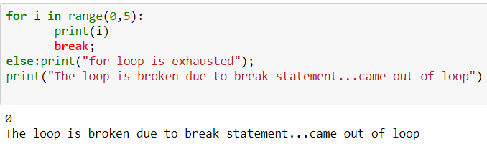
The loop is broken due to break statement therefore the else statement will not be executed.
The statement present immediate next to else block will be executed.

Slide 27

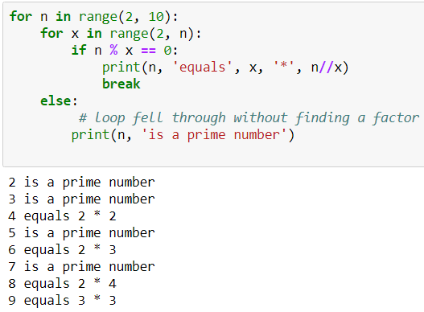
else clause is executed when the loop terminates through exhaustion of the list (with for)
or when the condition becomes false (with while), but not when the loop is terminated by a break statement.

Slide 28

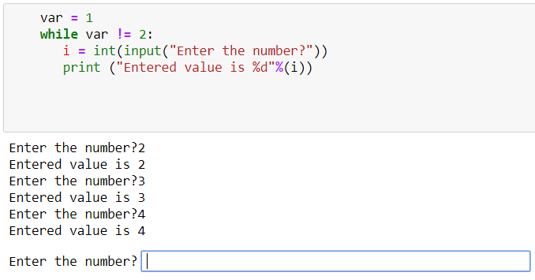
Examples of infinite while loops

Slide 29
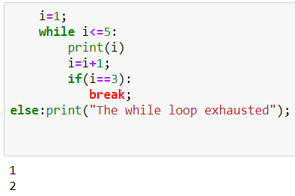
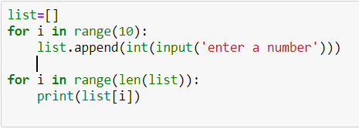
Python break statement
The break is a keyword in python which is used to bring the program control out of the loop.
The break statement breaks the loops one by one, i.e., in the case of nested loops, it breaks the inner loop first and then proceeds to outer loops.
In other words, we can say that break is used to abort the current execution of the program and the control goes to the next line after the loop.
The break is commonly used in the cases where we need to break the loop for a given condition.
The syntax of the break is given below.
#loop statements
break;

Slide 30
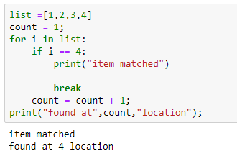
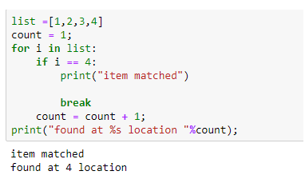
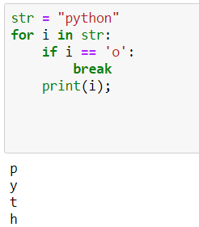
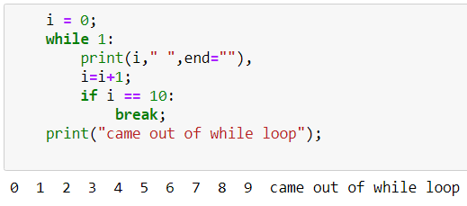

Slide 31
